Slide 1


Programming One (csc7050)
Aidan McGowan
OOP – Inheritance
Constructors
Super keyword
Protected access modifier

Slide 2
Inheritance - intro
Inheritance, which is a form of software reuse in which a new class is created by absorbing an existing class’s members and embellishing them with new or modified capabilities.
With inheritance, you can save time during program development by basing new classes on existing proven and debugged high-quality software. This also increases the likelihood that a system will be implemented and maintained effectively.

Slide 3
Recall - Class hierarchy
StaffMember
Doctor
Programmer

Slide 4

Constructors in OOP inheritance
Each subclass constructor must implicitly or explicitly call its superclass constructor to initialise the instance variables inherited from the superclass.
To explicitly call the superclass constructor you need to use the superclass constructor call syntax —keyword super, followed by a set of parentheses containing the superclass constructor arguments.
Notes:
package SuperCalls;
public class GrandFather {
public GrandFather(){
System.out.println("In constructor of Grandfather");
}
}
___________________________________________________________________________________________
package SuperCalls;
public class Father extends GrandFather {
public Father(){
System.out.println("Father constructor");
}
}
____________________________________________________________________________________________
package SuperCalls;
public class Son extends Father {
public Son(){
System.out.println("Son constructor ...");
}
}

Slide 5
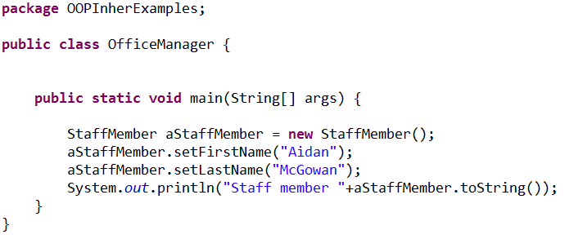
Previously – default constructor
Consider previously we created the StaffMember class using the default (no arguments) constructor

Slide 6
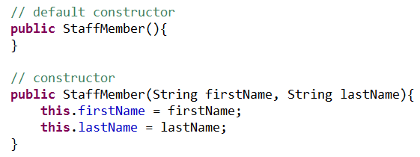
Update with constructor with arguments
Remember to include a default constructor as it will be overwritten as soon as you create one with arguments !

Slide 7
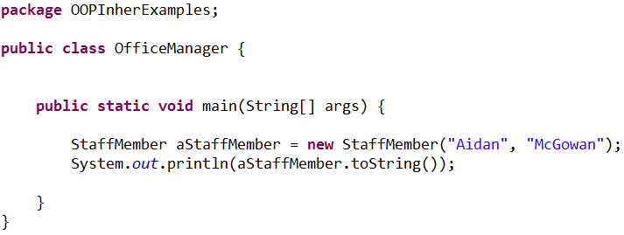
Using the constructor with arguments
So now we have the option to create the object and pass in the instance variable details at the same time

Slide 8
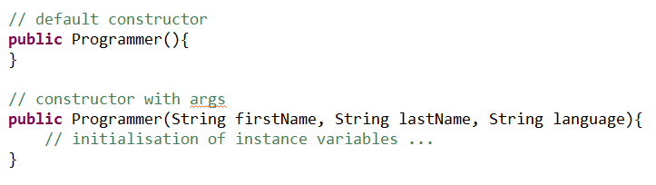
Constructors with subclasses
Recall that Programmer class extends the StaffMember and that one of the key principles of Inheritance is code reuse.
So adding a argument based constructor will look something like this …

Slide 9
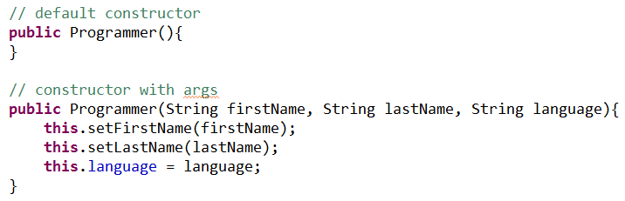
This works .. but not best practice
In this case the default constructor of the StaffMember is implicitly called and then the instance variables are set.
But we have a constructor that already does all this (and has been tested) in StaffMember ! So reuse it.

Slide 10
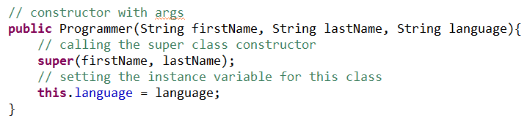
Super … best practice.
Calling the superclass constructor
The super keyword calls the super class constructor.

Slide 11
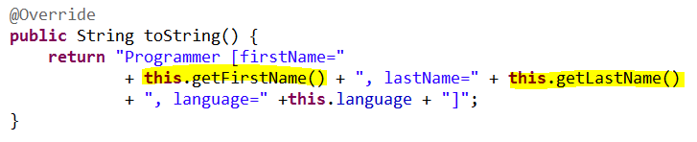
Hidden fields
When you extend a class, the new class inherits the superclass’s members—though the private superclass members are hidden in the new class.
Notes:
You can customize the new class to meet your needs by including additional members and by overriding superclass members.

Slide 12
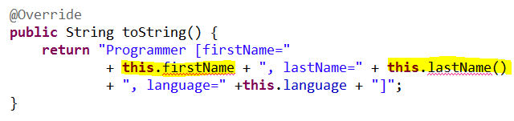
Hidden fields
The super class fields are hidden so this is not possible …
Notes:
You can customize the new class to meet your needs by including additional members and by overriding superclass members.

Slide 13
Constructor with Super – exercise I
Vehicle
- name : String - powerType : String
+ getName() : String + setName(name: String) + getPowerType() : String + setPowerType (powerType: String) + toString() : String
Update the previous Vehicle / Car and Ship OO hierarchy example to include an argument based constructor. Use super in subclass constructors.
Car
- numberOfWheels: int
+ getNumberOfWheels () : int + setNumberOfWheels (wardNumber: int) + toString() : String
Ship
- tonnage : int
+ getTonnage () : int + setTonnage (tonnage : int) + toString() : String
Notes:
package OOPInhertance;
public class Vehicle {
private String name;
private String powerType;
/**
* Default constructor
*/
public Vehicle(){
}
/**
* Constructor with args
* @param name
* @param powerType
*/
public Vehicle(String name, String powerType){
this.name = name;
this.powerType = powerType;
}
/**
* @return the name
*/
public String getName() {
return name;
}
/**
* @param name the name to set
*/
public void setName(String name) {
this.name = name;
}
/**
* @return the powerType
*/
public String getPowerType() {
return powerType;
}
/**
* @param powerType the powerType to set
*/
public void setPowerType(String powerType) {
this.powerType = powerType;
}
@Override
public String toString() {
return "Vehicle [name=" + name + ", powerType=" + powerType + "]";
}
}
________________________________________________________________________________________________________________
package OOPInhertance;
public class Car extends Vehicle {
private int numberOfWheels;
/**
* default constructor
*
*/
public Car() {
}
/**
* Constructor with args
*
* @param name
* @param powerType
*/
public Car(String name, String powerType, int numberOfWheels) {
super(name, powerType);
this.numberOfWheels = numberOfWheels;
}
/**
* @return the numberOfWheels
*/
public int getNumberOfWheels() {
return numberOfWheels;
}
/**
* @param numberOfWheels
* the numberOfWheels to set
*/
public void setNumberOfWheels(int numberOfWheels) {
this.numberOfWheels = numberOfWheels;
}
@Override
public String toString() {
return "Car [ name=" + this.getName() + " powertype="
+ this.getPowerType() + " numberOfWheels=" + numberOfWheels
+ "]";
}
}
_______________________________________________________________________________________________________________
package OOPInhertance;
public class Ship extends Vehicle {
private int tonnage;
public Ship(){
}
/**
* Constructor with args
* @param name
* @param powerType
*/
public Ship(String name, String powerType, int tonnage){
super(name,powerType);
this.tonnage = tonnage;
}
/**
* @return the tonnage
*/
public int getTonnage() {
return tonnage;
}
/**
* @param tonnage the tonnage to set
*/
public void setTonnage(int tonnage) {
this.tonnage = tonnage;
}
@Override
public String toString() {
return "Ship [ name="+ this.getName() +" powertype=" +this.getPowerType() +" tonnage=" + tonnage + "]";
}
}

Slide 14
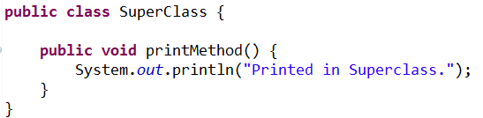
More super !
If a method overrides one of its superclass's methods, you can invoke the overridden method through the use of the keyword super.
Consider this superclass

Slide 15
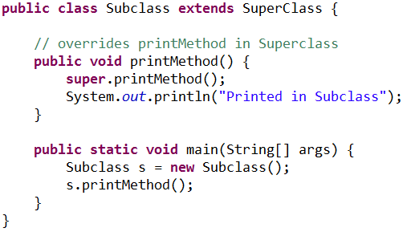

More super !
Here is a subclass, called Subclass, that overrides printMethod():

Slide 16



Exercise II
move()
Outputs to screen … “moving slowly”
GameCharacter
+ move()
Mario
+ move() + fly()
KoopaTroopa
+ hideInShell()
Overrides superclass move() outputs to screen … “moving fast”
Notes:
public class GameCharacter {
/**
* Makes the character move
*/
public void move(){
System.out.println("Moving slowly");
}
}
__________________________________________________________________________
public class KoopaTroopa extends GameCharacter{
/**
* Makes character hide in shell
*/
public void hideInShell(){
System.out.println("Hiding in shell");
}
}
_____________________________________________________________________________________________________________
public class Mario extends GameCharacter{
/**
* Makes the character move. Note overridden method
*/
@Override
public void move(){
System.out.println("Moving fast");
}
/**
* Makes the character fly
*/
public void fly(){
System.out.println("Flying");
}
}

Slide 17

Game changer
If Mario is made small he can only run slowly.. Update the game to cope with this. Hint you may need a instance var that indicates Mario’s size state and the run method may need to update, maybe use super.move() depending on the size of Mario.

Slide 18
Protected Members
For reference
So far we have seen modifiers public and private. A class’s public members are accessible wherever the program has a reference to an object of that class or one of its subclasses.
A class’s private members are accessible only within the class itself.
There is another type protected. Using protected access offers an intermediate level of access between public and private. A superclass’s protected members can be accessed by members of that superclass, by members of its subclasses and by members of other classes in the same package—protected members also have package access.

Slide 19
Protected Members (continued)
For reference
All public and protected superclass members retain their original access modifier when they become members of the subclass—public members of the superclass become public members of the subclass, and protected members of the superclass become protected members of the subclass. A superclass’s private members are not accessible outside the class itself. Rather, they’re hidden in its subclasses and can be accessed only through the public or protected methods inherited from the superclass.
Subclass methods can refer to public and protected members inherited from the superclass simply by using the member names. When a subclass method overrides an inherited superclass method, the superclass method can be accessed from the subclass by preceding the superclass method name with keyword super and a dot (.) separator. (Although this is not in keeping with rules of encapsulation)

